Slide 1
The Call of Abram
12 The Lord had said to Abram, “Go from your country, your people and your father’s household to the land I will show you.
² “I will make you into a great nation,
and I will bless you;
I will make your name great,
and you will be a blessing.^{[a]}
³ I will bless those who bless you,
and whoever curses you I will curse;
and all peoples on earth
will be blessed through you.”

Slide 2
4 So Abram went, as the Lord had told him; and Lot went with him. Abram was seventy-five years old when he set out from Harran. 5 He took his wife Sarai, his nephew Lot, all the possessions they had accumulated and the people they had acquired in Harran, and they set out for the land of Canaan, and they arrived there.
6 Abram traveled through the land as far as the site of the great tree of Moreh at Shechem. At that time the Canaanites were in the land. 7 The Lord appeared to Abram and said, “To your offspring[c] I will give this land.” So he built an altar there to the Lord, who had appeared to him.
8 From there he went on toward the hills east of Bethel and pitched his tent, with Bethel on the west and Ai on the east. There he built an altar to the Lord and called on the name of the Lord. 9 Then Abram set out and continued toward the Negev.

Slide 3

The Power of Obedience
Trust and Obey for there is no other way

Slide 4
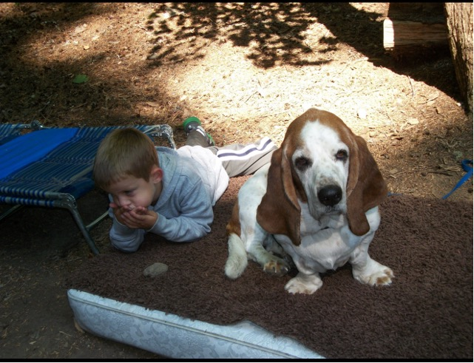
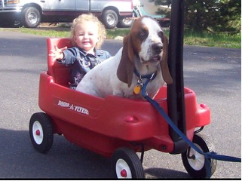
Walter the Bassett hound
But obedience to God isn’t about being a mindless robot. It’s about trust, relationship, and unlocking blessings we could never achieve on our own.

Slide 5
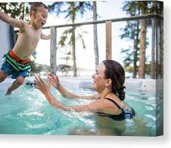
Swimming pool test
But what happens when you finally jump? He catches you! And then you realize—this is fun! Now you’re jumping over and over, even when he’s not ready!
Obedience to God is like that. We hesitate because we don’t see the whole picture. But once we step out in faith, we find that He’s already there, ready to catch us.
Scripture: Matthew 6:33 – “Seek first the kingdom of God and His righteousness, and all these things will be added to you.”

Slide 6
Abraham and Isaac – The Ultimate Test of Trust
⁴ On the third day Abraham looked up and saw the place in the distance. ⁵ He said to his servants, “Stay here with the donkey while I and the boy go over there. We will worship and then we will come back to you.”
⁶ Abraham took the wood for the burnt offering and placed it on his son Isaac, and he himself carried the fire and the knife. As the two of them went on together, ⁷ Isaac spoke up and said to his father Abraham, “Father?”
“Yes, my son?” Abraham replied.
“The fire and wood are here,” Isaac said, “but where is the lamb for the burnt offering?”
⁸ Abraham answered, “God himself will provide the lamb for the burnt offering, my son.” And the two of them went on together.
⁹ When they reached the place God had told him about, Abraham built an altar there and arranged the wood on it. He bound his son Isaac and laid him on the altar, on top of the wood. ¹⁰ Then he reached out his hand and took the knife to slay his son. ¹¹ But the angel of the Lord called out to him from heaven, “Abraham! Abraham!”
“Here I am,” he replied.
¹² “Do not lay a hand on the boy,” he said. “Do not do anything to him. Now I know that you fear God, because you have not withheld from me your son, your only son.”
¹³ Abraham looked up and there in a thicket he saw a ram^{[a]} caught by its horns. He went over and took the ram and sacrificed it as a burnt offering instead of his son. ¹⁴ So Abraham called that place The Lord Will Provide. And to this day it is said, “On the mountain of the Lord it will be provided.”

Slide 7

The Military Commander’s Orders
Imagine a soldier in the middle of battle. His commander tells him, “Hold this position!” But he looks around—enemy soldiers are everywhere, and holding the position seems crazy. He thinks, “Maybe I should run? Maybe I should do my own thing?”
But if he obeys, he realizes later that his commander had the full battle plan. His obedience wasn’t pointless—it was part of a bigger victory.
Jesus followed God’s plan, even though it looked like a loss. His obedience brought salvation to the world.

Slide 8
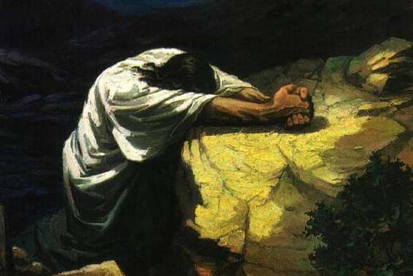
Jesus – The Ultimate Example of Obedience
Jesus didn’t just preach obedience—He lived it. He followed the Father’s will even when it led to the cross.
They went to a place called Gethsemane; and he said to his disciples, “Sit here while I pray.” He took with him Peter and James and John and began to be distressed and agitated. And he said to them, “I am deeply grieved, even to death; remain here, and keep awake.” And going a little farther, he threw himself on the ground and prayed that, if it were possible, the hour might pass from him. He said, “Abba, Father, for you all things are possible; remove this cup from me; yet, not what I want, but what you want.” —Mark 14:32-36

Slide 9
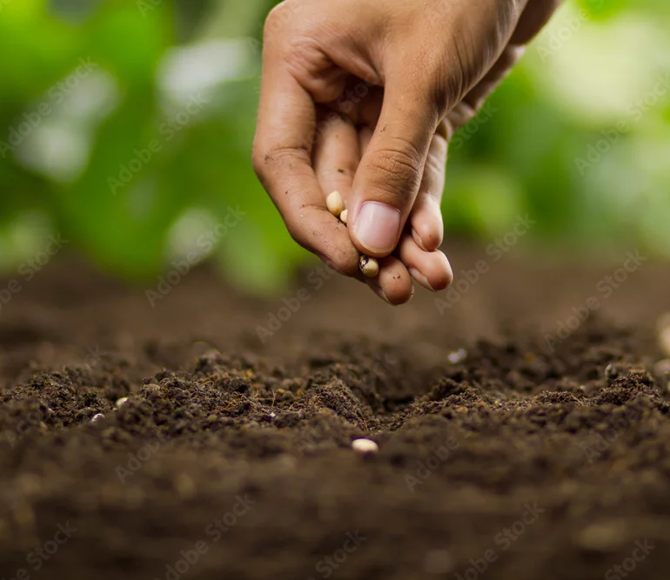
The Farmer’s Faith
A farmer plants seeds in the ground. He doesn’t see instant results, but he trusts that in time, there will be a harvest. Obedience works the same way—small steps of faith lead to great blessings.

Slide 10
How do we develop a lifestyle of obedience?
1. Listen to God’s voice – John 10:27: “My sheep listen to my voice; I know them, and they follow me.”
2. Trust even when you don’t understand – Proverbs 3:5-6: “Trust in the Lord with all your heart and lean not on your own understanding.”
3. Act in faith – James 2:17: “Faith by itself, if it is not accompanied by action, is dead.”

Slide 11
Examples of Blessings from Obedience:
Deuteronomy 28:1-2 – “If you fully obey the Lord your God… all these blessings will come on you.”
Psalm 128:1 – “Blessed are all who fear the Lord, who walk in obedience to him.”
1. Provision – Abraham obeyed, and God provided a ram. (Genesis 22:13-14)
2. Protection – Noah obeyed, and his family was saved from the flood. (Genesis 6:22)
3. Purpose – The disciples obeyed Jesus’ call and changed the world. (Matthew 4:19-20)

Slide 12
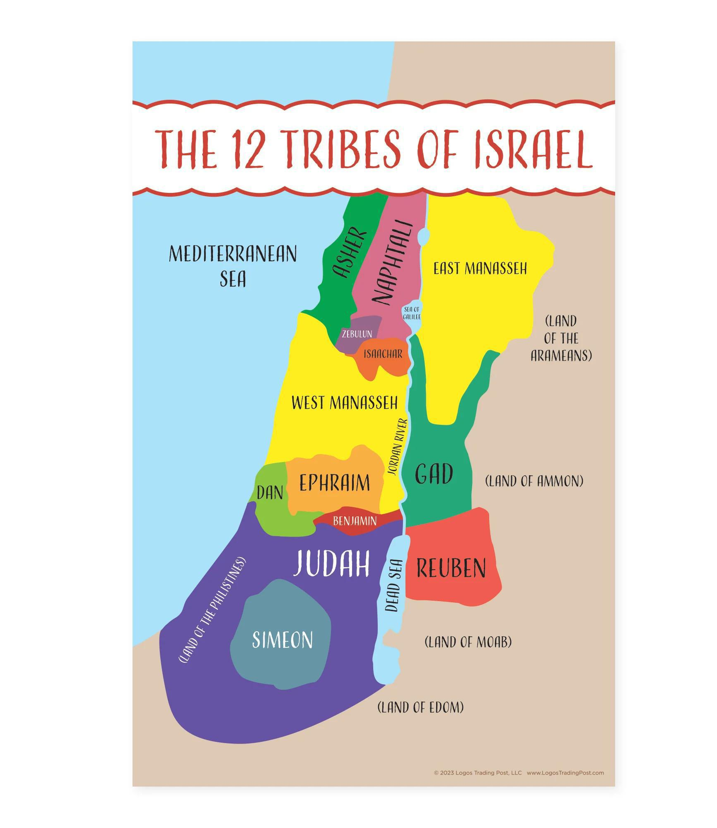
Father Abraham
Genesis 25:7-11
7 Abraham lived a hundred and seventy-five years. 8 Then Abraham breathed his last and died at a good old age, an old man and full of years; and he was gathered to his people. 9 His sons Isaac and Ishmael buried him in the cave of Machpelah near Mamre, in the field of Ephron son of Zohar the Hittite, 10 the field Abraham had bought from the Hittites. There Abraham was buried with his wife Sarah. 11 After Abraham’s death, God blessed his son Isaac, who then lived near Beer Lahai Roi.

Slide 13
