Slide 1
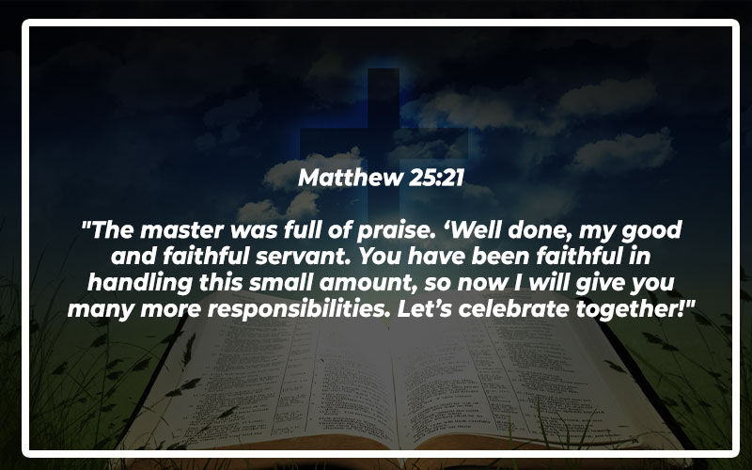

Slide 2
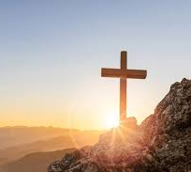

Remaining Faithful Till the End
Hebrews 10:23 – Let us hold firmly to the confession of our hope without wavering, for He who promised is faithful.

Slide 3
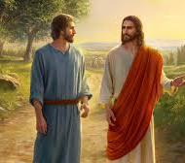
Peter’s Denial & Jesus’ Prayer
Luke 22:31-32 (NASB)
“Simon, Simon, behold, Satan has demanded to sift you men like wheat; but I have prayed for you, that your faith will not fail; and you, when you have turned back, strengthen your brothers.”

Slide 4
Luke 22:54-62
Peter Denies Jesus
54 Then they seized him and led him away, bringing him into the high priest's house, and Peter was following at a distance. 55 And when they had kindled a fire in the middle of the courtyard and sat down together, Peter sat down among them. 56 Then a servant girl, seeing him as he sat in the light and looking closely at him, said, “This man also was with him.” 57 But he denied it, saying, “Woman, I do not know him.” 58 And a little later someone else saw him and said, “You also are one of them.” But Peter said, “Man, I am not.” 59 And after an interval of about an hour still another insisted, saying, “Certainly this man also was with him, for he too is a Galilean.” 60 But Peter said, “Man, I do not know what you are talking about.” And immediately, while he was still speaking, the rooster crowed. 61 And the Lord turned and looked at Peter. And Peter remembered the saying of the Lord, how he had said to him, “Before the rooster crows today, you will deny me three times.” 62 And he went out and wept bitterly.

Slide 5
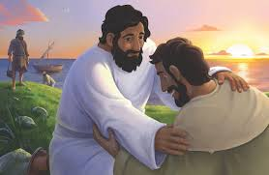
Peter’s Restoration
John 21:17 (NASB)
He said to him the third time, “Simon, son of John, do you love Me?” Peter was hurt because He said to him the third time, “Do you love Me?” And he said to Him, “Lord, You know all things; You know that I love You.” Jesus said to him, “Tend My sheep.”

Slide 6
The Parable of the Lost Son
11 Jesus continued: “There was a man who had two sons. 12 The younger one said to his father, ‘Father, give me my share of the estate.’ So he divided his property between them.
13 “Not long after that, the younger son got together all he had, set off for a distant country and there squandered his wealth in wild living. 14 After he had spent everything, there was a severe famine in that whole country, and he began to be in need. 15 So he went and hired himself out to a citizen of that country, who sent him to his fields to feed pigs. 16 He longed to fill his stomach with the pods that the pigs were eating, but no one gave him anything.
17 “When he came to his senses, he said, ‘How many of my father’s hired servants have food to spare, and here I am starving to death! 18 I will set out and go back to my father and say to him: Father, I have sinned against heaven and against you. 19 I am no longer worthy to be called your son; make me like one of your hired servants.’

Slide 7
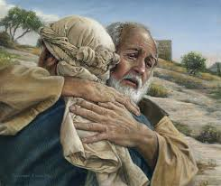
The Prodigal Son
Luke 15:20 (NASB)
So he set out and came to his father. But when he was still a long way off, his father saw him and felt compassion for him, and ran and embraced him and kissed him.

Slide 8
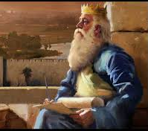
Solomon’s Reflection
Ecclesiastes 12:13-14 (NASB)
The conclusion, when everything has been heard, is: fear God and keep His commandments, because this applies to every person. For God will bring every act to judgment, everything which is hidden, whether it is good or evil.

Slide 9
2 Samuel 12:1-14
Nathan Rebukes David
12 The Lord sent Nathan to David. When he came to him, he said, “There were two men in a certain town, one rich and the other poor. 2 The rich man had a very large number of sheep and cattle, 3 but the poor man had nothing except one little ewe lamb he had bought. He raised it, and it grew up with him and his children. It shared his food, drank from his cup and even slept in his arms. It was like a daughter to him.
4 “Now a traveler came to the rich man, but the rich man refrained from taking one of his own sheep or cattle to prepare a meal for the traveler who had come to him. Instead, he took the ewe lamb that belonged to the poor man and prepared it for the one who had come to him.”
5 David burned with anger against the man and said to Nathan, “As surely as the Lord lives, the man who did this must die! 6 He must pay for that lamb four times over, because he did such a thing and had no pity.”
7 Then Nathan said to David, “You are the man! This is what the Lord, the God of Israel, says: ‘I anointed you king over Israel, and I delivered you from the hand of Saul. 8 I gave your master’s house to you, and your master’s wives into your arms. I gave you all Israel and Judah. And if all this had been too little, I would have given you even more. 9 Why did you despise the word of the Lord by doing what is evil in his eyes?

Slide 10
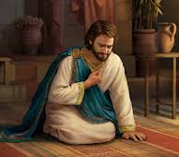
David’s Repentance
Psalm 51:10-12 (NASB)
Create in me a clean heart, God, and renew a steadfast spirit within me. Do not cast me away from Your presence, and do not take Your Holy Spirit from me. Restore to me the joy of Your salvation, and sustain me with a willing spirit.

Slide 11

There’s Always a Way Back
Romans 8:1 (NASB)
Therefore there is now no condemnation at all for those who are in Christ Jesus.
Jacob and Esau
Genesis 35:1 “Then God said to Jacob. “Arise, go up to Bethel and live there, and make an alter there to God, who appeared to you when you fled from your brother Esau

Slide 12

GPS Grace
GPS that is constantly Recalculating
We take the wrong road, and instead of yelling, God calmly says:
“Recalculating… take the next right and come back to Me.”
God never cancels the destination- He just helps us find a new way there

Slide 13

Conclusion: Stay the Course
No matter what you've done...
• Like Peter, you can come back and lead.
• Like the prodigal, you can return to the Father.
• Like Solomon, you can find wisdom again.
• Like David, you can be forgiven and restored.
Stay faithful. God is not done with you yet!

