Slide 1
Romans 3:19-26
19 Now we know that whatever the law says, it says to those who are under the law, so that every mouth may be silenced and the whole world held accountable to God. 20 Therefore no one will be declared righteous in God’s sight by the works of the law; rather, through the law we become conscious of our sin.
Righteousness Through Faith
21 But now apart from the law the righteousness of God has been made known, to which the Law and the Prophets testify. 22 This righteousness is given through faith in Jesus Christ to all who believe. There is no difference between Jew and Gentile, 23 for all have sinned and fall short of the glory of God, 24 and all are justified freely by his grace through the redemption that came by Christ Jesus. 25 God presented Christ as a sacrifice of atonement, through the shedding of his blood—to be received by faith. He did this to demonstrate his righteousness, because in his forbearance he had left the sins committed beforehand unpunished— 26 he did it to demonstrate his righteousness at the present time, so as to be just and the one who justifies those who have faith in Jesus.

Slide 2

The God we don’t know…
Matthew 7:21–23:
“Not everyone who says to me, ‘Lord, Lord,’ will enter the kingdom of heaven, but the one who does the will of my Father who is in heaven. On that day many will say to me, ‘Lord, Lord, did we not prophesy in your name, and cast out demons in your name, and do many mighty works in your name?’ And then will I declare to them, ‘I never knew you; depart from me, you workers of lawlessness.’”

Slide 3

Do you actually know God—or do you just know about Him?
You can know everything about Taylor Swift—where she’s from, what albums she’s released, who she’s dating—but if you tried to walk into her house and say you’re friends, security would throw you out. Why? Because *you* might know *about* her, but she doesn’t know you.

Slide 4
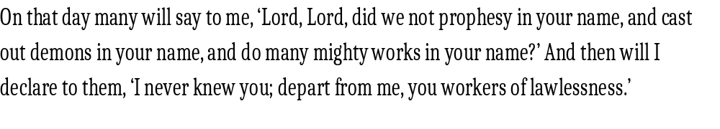
God is Not Your Buddy, Life Coach, or Therapist
Just like when I got to Taylor Swifts house and security throws me out, the scary thing is, Jesus says the same thing can happen between us and Him.

Slide 5
He is your King
Isaiah 6:1–5 paints the picture of what it looks like to truly encounter God:
“In the year that King Uzziah died I saw the Lord sitting upon a throne, high and lifted up; and the train of his robe filled the temple. Above him stood the seraphim... And one called to another and said: ‘Holy, holy, holy is the Lord of hosts; the whole earth is full of his glory!’ And the foundations of the thresholds shook at the voice of him who called, and the house was filled with smoke. And I said: ‘Woe is me! For I am lost; for I am a man of unclean lips... and my eyes have seen the King, the Lord of hosts!’”
That doesn’t sound like a buddy. That sounds like a Judge, a King, a consuming fire (Hebrews 12:28–29)

Slide 6
We’ve Lost the Fear of God
Proverbs 9:10 says, “The fear of the Lord is the beginning of wisdom.” Not love, not comfort—*fear*. Fear means reverence, awe, submission.
Acts 5:1–11 Ananias and Sapphira
5 Now a man named Ananias, together with his wife Sapphira, also sold a piece of property. 2 With his wife’s full knowledge he kept back part of the money for himself, but brought the rest and put it at the apostles’ feet.
3 Then Peter said, “Ananias, how is it that Satan has so filled your heart that you have lied to the Holy Spirit and have kept for yourself some of the money you received for the land? 4 Didn’t it belong to you before it was sold? And after it was sold, wasn’t the money at your disposal? What made you think of doing such a thing? You have not lied just to human beings but to God.”
5 When Ananias heard this, he fell down and died. And great fear seized all who heard what had happened.
When’s the last time someone dropped dead in a church building because they disrespected God? We act like it’s no big deal. We need to remember who we’re dealing with.

Slide 7
Everyone Thinks They’re a Good Person—They Aren’t
Romans 3:10–12: “None is righteous, no, not one; no one understands; no one seeks for God. All have turned aside... no one does good, not even one.”
Matthew 7:13–14: “Enter by the narrow gate. For the gate is wide and the way is easy that leads to destruction, and those who enter by it are many. For the gate is narrow and the way is hard that leads to life, and those who find it are few.”
It’s not unloving to say this—it’s loving to tell people the truth. Hell is real. Jesus spoke of it more than anyone.
We don’t all go to a 'better place.' We go to one of two places.

Slide 8
Church isn’t about you, Worship isn’t about you
Ever heard someone say, “I didn’t like the worship today”? That’s fine—but we weren’t worshipping you.
Leviticus 10:1–3 tells how Nadab and Abihu offered 'unauthorized fire' before the Lord—and were consumed by fire.
God said, 'Among those who are near me I will be sanctified, and before all the people I will be glorified.'
Worship is about God, not music style or emotion. John 4:24 says, “God is spirit, and those who worship him must worship in spirit and truth.”
Are we that selfish that we think we must please ourselves to honor God?

Slide 9
Evolution’s Lie — You Came From Nothing, You Go Nowhere, You Live for Yourself
Evolution tells you you're a cosmic accident. No purpose, no meaning, no accountability.
Psalm 139:13–16 says:
“For you formed my inward parts; you knitted me together in my mother’s womb. I praise you, for I am fearfully and wonderfully made. Wonderful are your works; my soul knows it very well... in your book were written, every one of them, the days that were formed for me.”
Romans 1:20–25 says people have exchanged the truth about God for a lie:
“Claiming to be wise, they became fools... they exchanged the truth about God for a lie and worshiped and served the creature (or creation) rather than the Creator.”

Slide 10
Conclusion:
Let’s go back to where we started. Jesus said, 'I never knew you.' That’s the most terrifying sentence in Scripture.
You can go to church. You can sing the songs. You can know your Bible. But if you don’t know Him—and if He doesn’t know you—you’re lost.
Today, the invitation is open. Know Him. Fear Him. Worship Him the way He demands, not the way you prefer.
Don’t be one of the many on the wide road who say, 'Lord, Lord'—but be one of the few who truly follow Him.

Slide 11
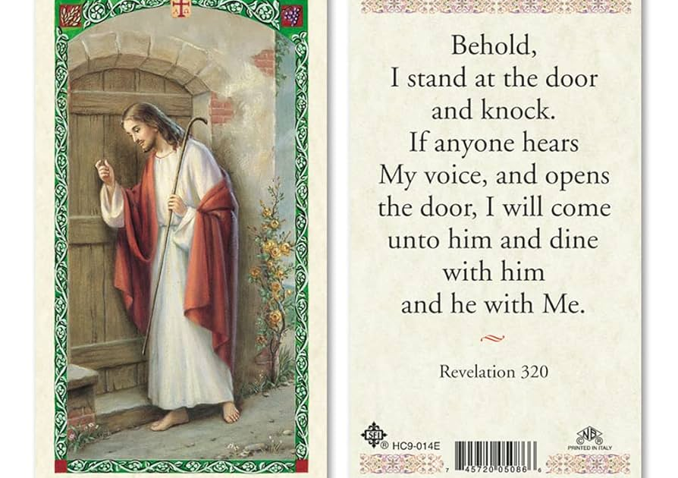
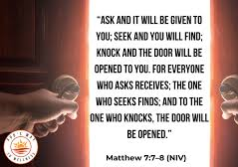
2 Verses both about knocking….
Do you hear Jesus knocking on your heart? Revelation 3:20
Have you sought after the Lord and knocked on his door to get to know him? Matthew 7:7-8
Unlike with Taylor Swift, Jesus is inviting you to come into his house, to get to know him, and to dine with him and to live with him forever.

